Slide 1

Student Exam Performance Analysis
Presented by:
Sai Keerthi Ambati 2401600189
Chitti Swarupa 2401600120
Dittakavi Jaya Satya Sai 2401600198
Kedasi Sailaja 2401600187
Ghanta Pravallika 2401600119

Slide 2
Contents
Abstract
Introduction
Problem Statement
Objectives
Significance of Study
Dataset Overview
Environment and Tools
Methodology
Exploratory Data Analysis
Feature importance
Predictive modelling
Key insights
Recommendations
Future Scope
Advantages and Disadvantages
Conclusion

Slide 3
Abstract
This study presents an in-depth analysis of student exam performance data using Python's powerful data manipulation library, Pandas, along with visualization tools like Matplotlib and Seaborn.
The dataset used in this analysis includes 1000 student records with attributes such as gender, age, parental background, attendance, study habits, sleep duration, stress levels, and exam scores.
The main problem addressed in this study is identifying which factors most significantly influence student academic performance and how these insights can support better learning outcomes.

Slide 4
Introduction
In today's education system, understanding what influences student performance is essential for improving learning outcomes and supporting academic success.
With increasing academic pressure and diverse student backgrounds, educators face the challenge of identifying key factors that impact student achievement.
This study uses the power of Python libraries such as Pandas, NumPy, Matplotlib, and Seaborn to perform a detailed analysis of student data.
Through data preprocessing, exploration, and visualization, we aim to uncover meaningful patterns and trends that can guide students, teachers, and parents in making informed decisions for better academic performance.

Slide 5
Problem Statement
How can we leverage data analysis techniques to explore and understand various academic and personal factors—such as attendance, study habits, stress levels, and parental background—to predict student exam performance, enabling educators to take early action and improve learning outcomes?

Slide 6
Objectives
Analyze academic and personal factors influencing performance
Visualize patterns using graphs and plots
Identify key factors affecting scores
Provide insights for educators and students

Slide 7
Significance of the Study
This study plays a vital role in enhancing educational outcomes through data analysis. By identifying patterns and trends in student performance:
It promotes data-driven learning strategies, allowing students and educators to focus on what works best.
It helps in the early identification of underperforming students, enabling timely support and intervention.
It provides valuable insights for policymakers and educators to design effective academic plans, support systems, and policies tailored to student needs.
Overall, this study supports a more informed, targeted, and efficient approach to improving student achievement.

Slide 8
Dataset Overview
1000 Student Records
Demographics: Gender, Age
Family: Parents’ Education, Occupation, Family Income
Academic: Attendance (%), Assignment Submission Rate (%), Previous Exam Performance, Exam Scores
Lifestyle: Hours of Study per Day, Hours of Sleep, Stress Level, Health Status, Class Participation
Support: Test Preparation, Tuition, Self-Study Hours, Extracurricular Activities, Study Mode (Online/Offline)

Slide 9
Environment and Tools
Development Environment:
Jupyter Notebook A web-based interactive environment used for writing and executing Python code, ideal for data analysis and visualization.
Programming Language:
Python 3.x Widely used for data science due to its readability and extensive libraries.
Libraries and Tools Used:
Pandas: For data manipulation and analysis
NumPy: For handling numerical data and computations
Matplotlib & Seaborn: For creating visualizations and plots
System Requirements:
OS: Windows, Linux, or macOS
RAM: Minimum 4GB (8GB recommended)
Storage: ~1GB free space for dataset and libraries
Processor: Basic dual-core or higher

Slide 10
Methodology
The project followed a structured data analysis workflow using Python and its data science libraries:
Data Collection
Used a custom dataset containing 1000 student records with academic and personal attributes.
Data Preprocessing
Cleaned missing values, encoded categorical variables, normalized numerical fields, and selected relevant features.
Exploratory Data Analysis (EDA)
Explored distributions and patterns using summary statistics and correlation analysis.
Data Visualization
Created plots (bar charts, scatter plots, heatmaps) to identify relationships between variables and exam performance.
Feature Importance Analysis
Determined which factors (e.g., attendance, stress, study habits) have the greatest impact on scores.
Insights & Recommendations
Interpreted the results to draw actionable insights for students, teachers.

Slide 11
Exploratory Data Analysis(EDA)
EDA is the most important part of understanding the dataset. In this phase, we applied various Pandas and NumPy functions to explore:
Basic summary statistics (mean, min, max, mode, variance)
Dataset shape, types, and missing value analysis
Logical filtering (e.g., students with >85% marks, female students who passed)
Grouping (e.g., average scores by gender or parental education level)
Sorting based on performance, study time, or attendance
Identifying potential performance trends based on academic habits
This step allowed us to observe the relationships between different factors and student performance.

Slide 12
Visualizations
To better understand the relationships between academic and personal factors and student performance, we used various data visualizations. These plots help uncover patterns, trends, and correlations that are not immediately visible in raw data. Using Matplotlib and Seaborn, we visualized key variables such as attendance, study hours, stress level, and assignment submission, comparing them with both actual and expected exam scores.
Visualizations were created using Matplotlib and Seaborn.
Helped explore patterns and trends in student performance
Compared actual vs expected scores for deeper insights
Focused on key factors like attendance, stress, study habits etc.

Slide 13
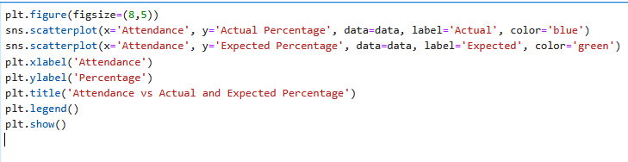
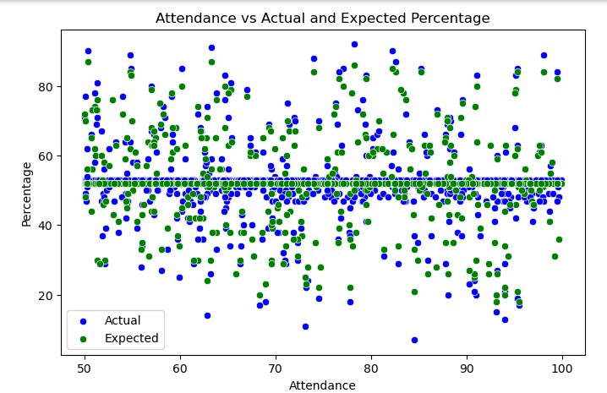
Scatter Plot (Attendance vs Actual and Expected percentage)
Students with higher attendance generally have better exam scores
Both actual and expected percentage increase as attendance increases
Regular class attendance supports consistent academic performance

Slide 14
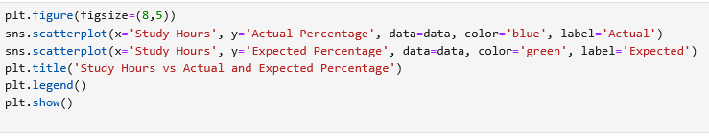
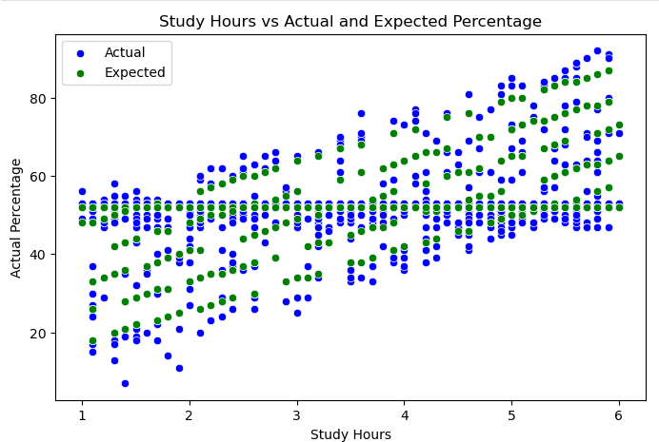
2. Scatter plot (Study hours vs Actual and Expected Percentage)
Students who study more hours tend to achieve higher scores
Both actual and expected percentages show a rising trend with more study hours
Consistent study habits have a direct impact on performance
This plot clearly shows that study time is strong predictor of academic success.

Slide 15
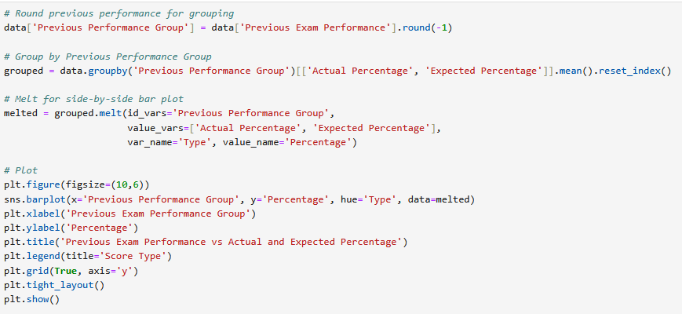
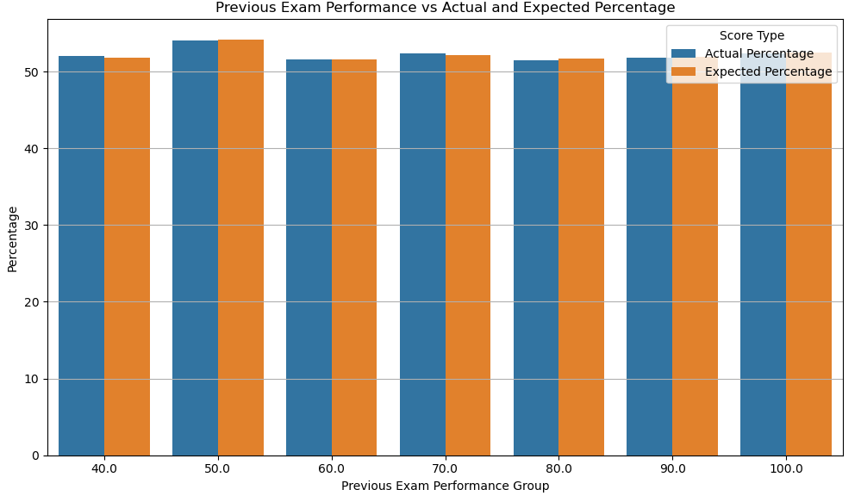
3. Bar Plot(Previous Exam Performance vs Actual and Expected percentage)
Students with higher previous exam scores tend to perform better in current exams
Past academic performance is a strong indicator of future success
This plot shows a consistent positive trend between previous and current exam outcomes.

Slide 16
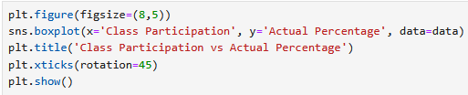
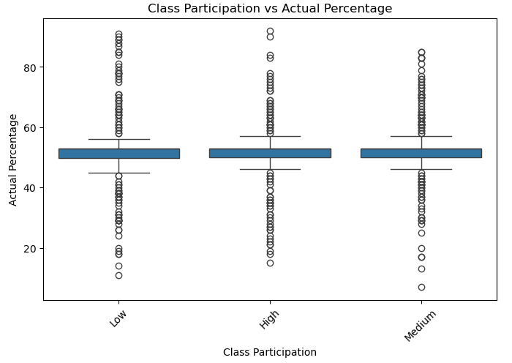
4. Box Plot(Class participation vs Actual Percentage)
Students with higher class participation tend to score better in exams
The median score increases with more active participation
There’s less score variation among highly participative students.

Slide 17

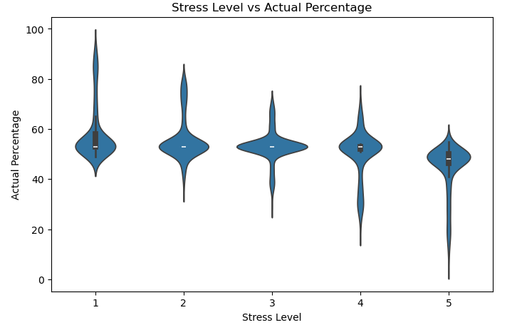
5. Violin plot(Stress Level vs Actual Percentage)
Students with lower stress levels generally score higher in exams
As stress level increases, the distribution of scores becomes more spread out and lower.
Managing stress is important for maintaining better exam outcomes.

Slide 18
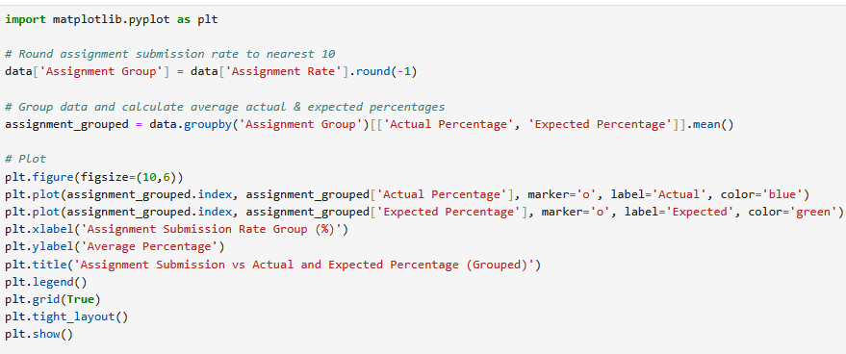
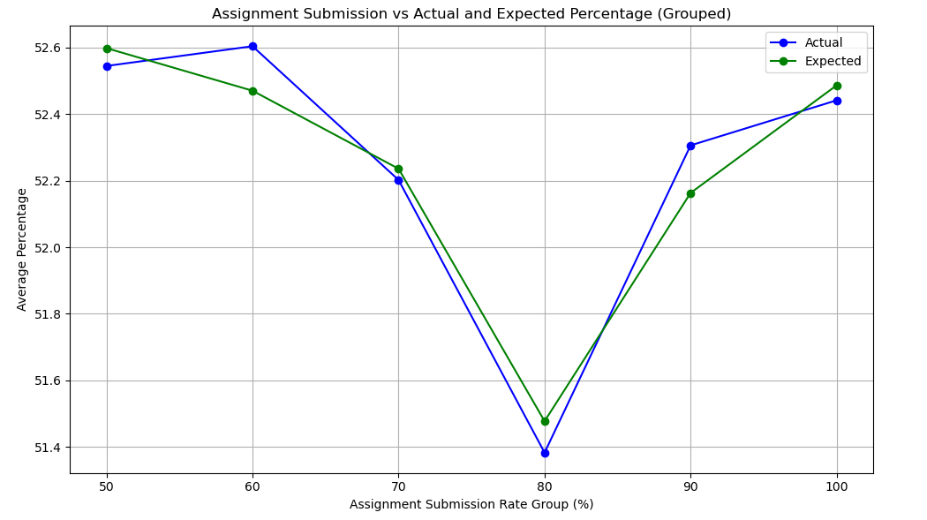
6. Line plot(Assignment Submission vs Actual and Expected Percentage)
Students with higher assignment submission rates score better in exams
There’s a strong positive relationship between assignment completion and performance of students in exam.

Slide 19
Feature Importance
Top factors influencing student exam performance:
Study Time Consistent study habits lead to significantly higher scores.
Sleep Duration 6–8 hours of sleep improves focus and reduces stress.
Attendance Students with better attendance perform more consistently in exams.
Class Participation Active classroom engagement improves understanding and retention.
Assignment Submission Timely assignment submissions indicate responsibility and boost performance.

Slide 20
Predictive Modeling : Student Performance
The student’s performance is analyzed based on various academic and behavioral features such as:
Study Hours
Attendance Percentage
Sleep Duration
Stress Level
Class Participation
Previous Exam Performance
Assignment Submission Rate

Slide 21
Key Insights
Study hours and attendance are the top predictors of performance.
Students with consistent routines and healthy habits tend to score higher.
High stress and poor sleep contribute to noticeable performance drops.
Test preparation support is especially beneficial for low-performing students.
Health and well-being significantly impact exam outcomes.
Class participation enhances understanding and retention.

Slide 22
Recommendations
Encourage 6–8 hours of sleep and promote regular study routines
Monitor and intervene when attendance drops below 80%
Promote healthy stress management through workshops and counseling
Recognize and reward timely assignment submissions
Encourage active class participation through interactive teaching methods
Implement AI-based Smart Tutoring Systems for personalized learning
Regularly track students’ emotional well-being using feedback tools

Slide 23
Future Scope
.
Live Progress Tracking
A live dashboard can be made for teachers to quickly see how students are doing and help them on time if needed.
Better Prediction Models
Smarter computer models (like AI) can be used to more accurately guess how students will perform in exams.
Personal Study Tips for Each Student
It can give each student personal advice like how many hours to study, when to sleep, or how to manage stress.

Slide 24
Project outcome
Identified the main factors affecting student exam performance, such as study hours, attendance, and stress level
Used Python tools like Pandas, Matplotlib, and Seaborn to analyze and visualize data
Created clean, readable charts to show patterns and trends in student behavior
Helped understand how academic habits and well-being impact exam scores
Provided useful insights that can support teachers in improving student outcomes
Showed the importance of using data-driven methods in education

Slide 25
Advantages
Data-Driven Decisions
Empowers educators and institutions to identify at-risk students early and provide timely interventions.
Scalable & Reusable Model
The analysis framework can be applied across multiple schools or academic years using similar data structures.
Customizable Interventions
Enables the generation of personalized study plans and support strategies based on individual student profiles.

Slide 26
Disadvantages
Limited Data Variety
The dataset does not cover emotional, behavioral, or external influences such as family issues or peer pressure.
Bias in Self-reported Inputs
Subjective variables like stress levels or health status may not reflect actual conditions accurately.
Dependence on Data Quality
Results are only as good as the completeness and accuracy of the dataset.
Technology Access
The project depends on tools like Python and Jupyter, which may not be readily available or accessible in all educational institutions.

Slide 27
Conclusion
The student performance analysis using Python, Pandas, Matplotlib, and Seaborn has uncovered key academic and behavioral patterns that significantly affect exam outcomes.
Through structured data exploration and visualization, this project provides practical insights that can help educators make smarter, more timely decisions to guide students toward academic improvement.
Embracing data analytics in education has the potential to personalize learning, identify struggling students early, and build a more supportive and effective academic environment.
This project demonstrates how data-driven strategies can bridge the gap between student potential and performance, paving the way for a more inclusive and outcome-focused education system.

Slide 28


